Slide 1
Automated cross-platform testing
May 2017
Artur Chrapowicki & Bartosz Pendolski

Slide 2
Agenda
Introduction
Test recording or test coding
Return on Investment with case study
Coded tests Page Object Pattern
with Demo
Cross-Platform testing
with Demo
Q&A

Slide 3

Test Automation
Automation does not do what testers used to do, unless one ignores most things a tester really does. Automated testing is useful for extending the reach of the testers work, not to replace it.”
James Bach

Slide 4
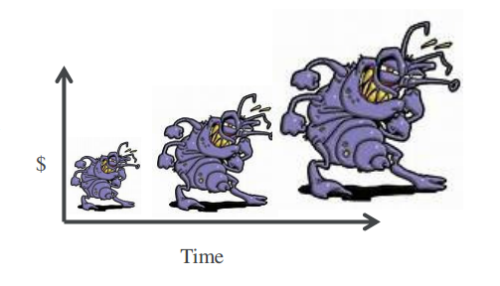
1:10:100
"1:10:100" rule. A defect that costs $1 to fix in requirements or design costs $10 to fix in a traditional test phase and $100 to fix after the product goes into production (live) use.

Slide 5
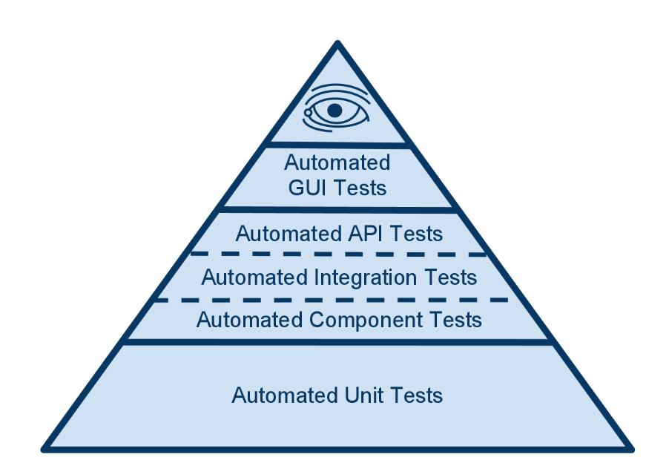
Test Automation Pyramid

Slide 6
History of GUI Test Automation Tools
Auto Tester 1985
2004 Selenium
1991 Xrunner
Bugzilla 1998
JIRA 2002
1999 QuickTest

Slide 7
Introduction to Test Automation
Test Tool Selection
Define Scope of Automation
Planning, Design and Development
Test Execution
Maintenance

Slide 8


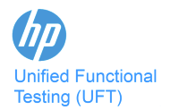







Test Recording and Test Coding
Notes:
IDE

Slide 9
Test recording
Saves time
No need to design the structure
Immediate feedback on quality
Everybody can use it
Unstable
One change to GUI will block multiple scripts
Hard to maintain
One platform only
Vendor dependancy

Slide 10
Test coding – Page Object Pattern
Resistant to GUI changes
Easy to create iterations of tests
Possibility to use same tests across platforms
Easy to maintain
Steep learning curve
Should be well thought and designed first
Takes time and effort to develop
Problems with certain GUI elements

Slide 11
Effort Comparison
Recorded tests
22%
Test design and preparation
34%
Test Execution
44%
Test Maintenance
Coded tests
44%
Test design and preparation
34%
Test Execution
22%
Test Maintenance

Slide 12
Cost comparison

Slide 13



Summary
Manual testing
Recorded tests
Coded tests
Notes:
Handcar, steam engine, train

Slide 14
Return on investment
$ROI=\frac{Gain from Investment −Cost of Investment}{Cost of Investment}$ x 100

Slide 15
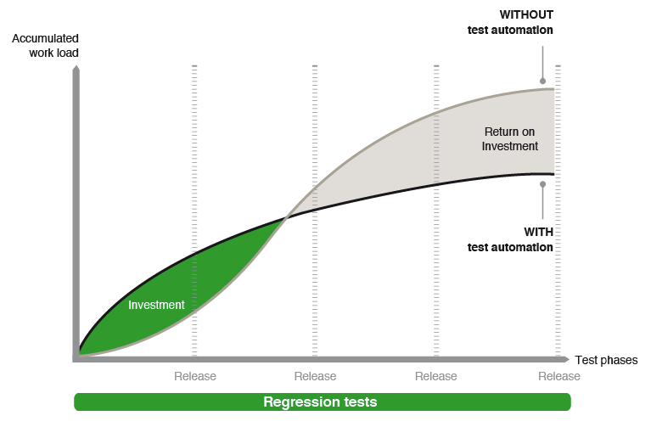
Return on investment

Slide 16
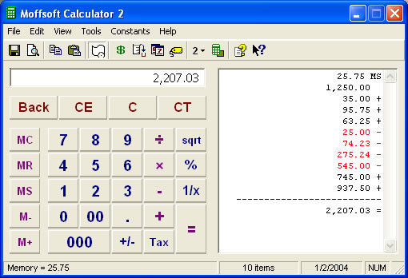
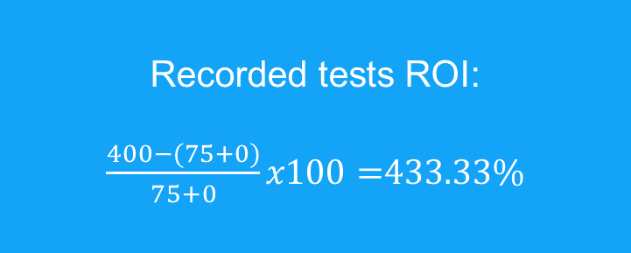
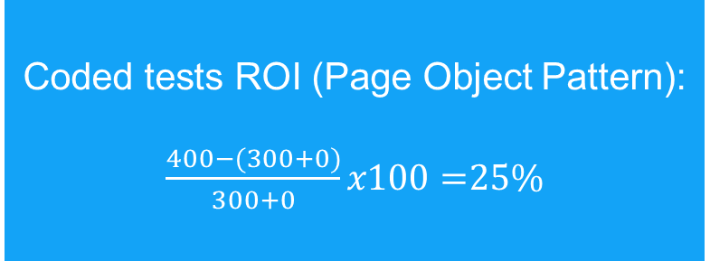
Case 1
8 Cycles
10 min to test manually each test
15 min to record each test
60 min to code each tests
0 min maintenance of coded
0 min maintenance of recorded
5 Test cases
Recorded tests ROI:
$\frac{400−(75+0)}{75+0}x100=$433.33%
Coded tests ROI (Page Object Pattern):
$\frac{400−(300+0)}{300+0}x100=$25%

Slide 17
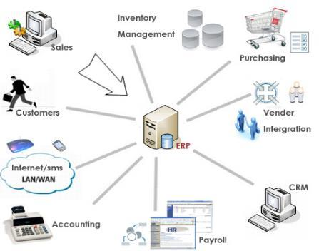
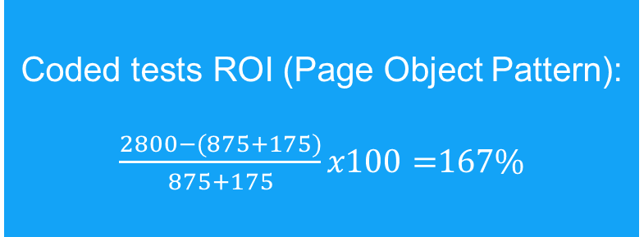
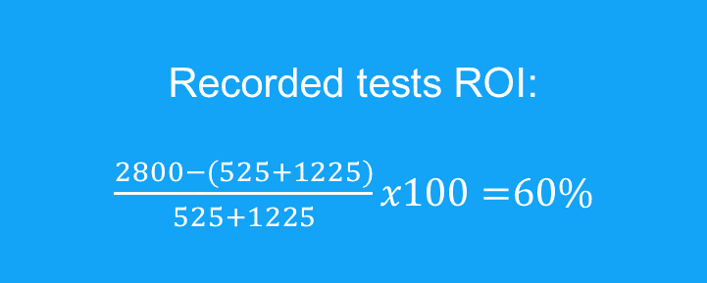
Case 2
8 Cycles
10 min to test manually each test
15 min to record each test
25 min to code each tests
5 min maintenance of coded
30 min maintenance of recorded
35 Test cases
Recorded tests ROI:
$\frac{2800−(525+1225)}{525+1225}x100=$60%
Coded tests ROI (Page Object Pattern):
$\frac{2800−(875+175)}{875+175}x100=$167%

Slide 18
Which to use?
Test Coding: - big projects (ERP, Finance solutions, online stores) - complex apps - cross-platform apps - many iterations of business scenarios
Test Recording:
- simple apps (calculator, mobile calendar, home budget) - ad hoc tests - little to test - no iterations of business scenarios - test data creation
Notes:
What kind of software is it? Are we only maintaining it or is it still being developed?
Cost for coded tests: time to plan and develop
Savings for coded tests: maintenance

Slide 19
Test Recording or Test Coding - Summary
Not all of tester’s tasks can be automated
What kind of software are we testing? Do we only maintain it or is it still being developed?
There are a lot of tools, find which one suits your needs the most
Test Recording – low effort at the start, high in maintenance
Test Coding – big effort at the start, pays off in maintenance
Test Recording and Test Coding can be used simultaneously

Slide 20
Agenda
Introduction
Test recording or test coding (Page Object Pattern)
Return on Investment with case study
Coded tests Page Object Pattern
with Demo
Cross-Platform testing
with Demo
Q&A
Notes:
- Introduce myself (I have been working on End to End tests automation from almost 5 years; In the previous project I worked we succesfully implemented automated tests fully integrated with our CI proces. Now I have been working on implementation End2End test in current project. So basicly a lot of time spent on tests automation in the past. But maybe let’s go to the more interesting things and lets me share those experiences.

Slide 21
Coded tests
Manual testing
Recorded tests
Coded tests
Notes:
- let’s recall the slide which Bartek showed and let’s go into the train. We can choose different type of trains we want to travel

Slide 22

Coded tests
TGV
Slow train
Notes:
We can travel with very fast TGV train, but also we can choose cheaper but slower Polish regional train
I want to show you today how to design your codded test to develop them as fast as TGV trains are.

Slide 23

Coded tests
Test Scenario
Web
Notes:
Let´s consider the scenario that you are startup company and have an great idea for web application.
As you are verry keen on quality you decided that you want to implement coded end to end automated tests for your application.

Slide 24
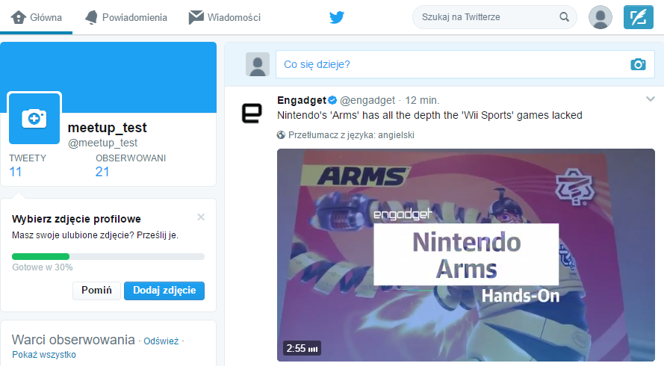
Test Scenario – Step 1
Notes:
- Let´s assume that we built Twitter website and we want to implement automated tests for it.
- As most important thing on twitter is publishing tweets we will try to test this functionallity. When we are looking at homepage we can see that to publish tweet we need to click input fiel

Slide 25
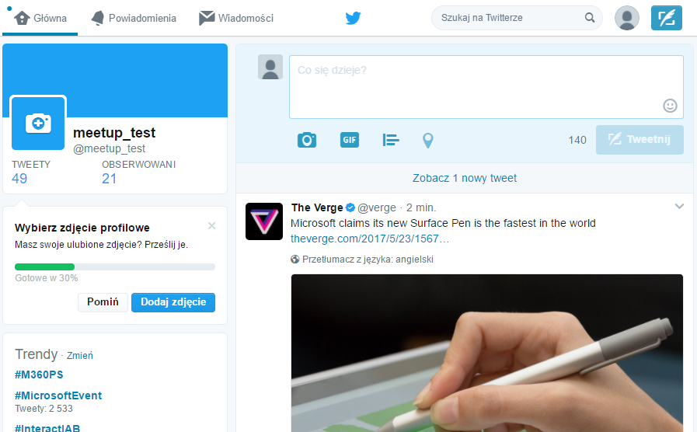
Test Scenario – Step 2
Notes:
- Then type our message

Slide 26
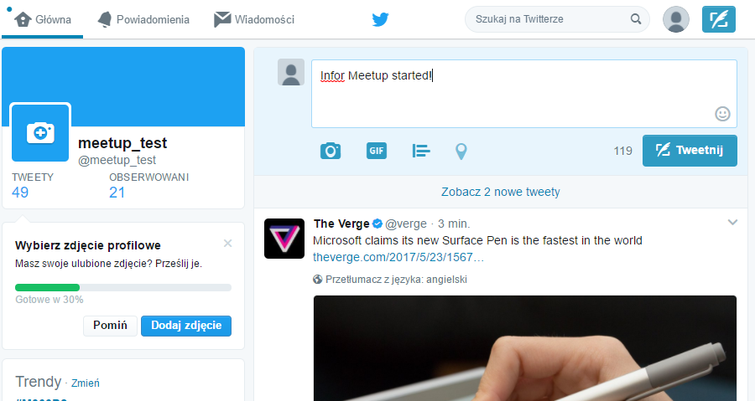
Test Scenario – Step 3
Notes:
And click „Tweet” buton.

Slide 27
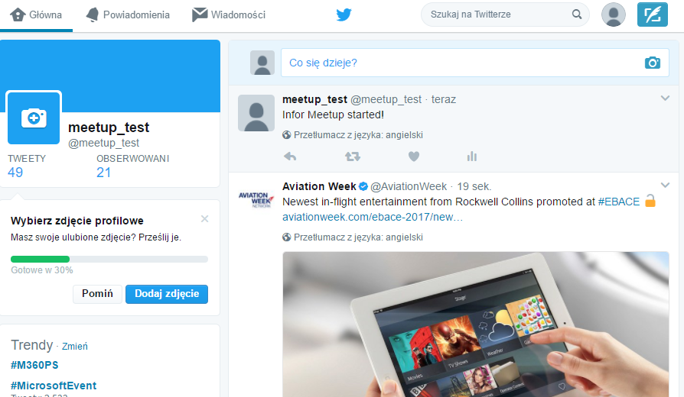
Test Scenario – Step 4
Notes:
The tweet should appear on our tweeter dashboard.
Let’s now start to create the test.

Slide 28








Coded tests – Web Frameworks
Notes:
On the market there are a lot of vendors which provide frameworks for testing web application. There are some only Java based, .Net or ruby. You can choose any one which is most close to technology you are using. I will use Selenium with C# today. It suports also: Java, C#, Ruby, Python, JavaScript, so you can use any of this language

Slide 29
Demo 1
https://github.com/achrapowicki/cross-platform-testing/tree/master/Demo1/Tweeter.Tests
Notes:
- Bad example

Slide 30
Demo 1 - Issues
Test cases are difficult to read
Changes in the UI breaks multiple tests often in several places
Duplication of selectors inside and across tests

Slide 31
Page Object Pattern
Navigation bar
Create Tweet
Side menu
Tweets
stream
Notes:
Let’s look at the Twitter website again and try to divide it for sections.
So instead of having each test fetch elements directly and being fragile towards UI changes, the Page Object Pattern introduces what is basically a decoupling layer.
You create an object that represents the UI you want to test, which could be a whole page or a significant part of it. Read more at https://www.pluralsight.com/guides/software-engineering-best-practices/getting-started-with-page-object-pattern-for-your-selenium-tests#RJWupyYTOWCJB7XU.99
We have ….

Slide 32
Page Object Pattern
Publish Tweet Test
TweetLessThan140Signs_Published()
…
Navigation bar
GoToNewTweet()
GoToMessages()
Create Tweet
PutMessage()
Publish()
Tweet stream
GetLastTweet()
ReplayTweet()
GoTo…()
AttacheImage()
…
ForwardTweet()
Notes:
- Let´s assume that we built Twitter website and we want to implement automated tests for it.
- As most important thing on twitter is publishing tweets we will try to test this functionallity. When we are looking at homepage we can see that to publish tweet we need to click input field put

Slide 33
Demo 2
https://github.com/achrapowicki/cross-platform-testing
Notes:
- Good example with adding new test

Slide 34

Cross-Platform testing
Test Scenario
Mobile
Web
Desktop

Slide 35
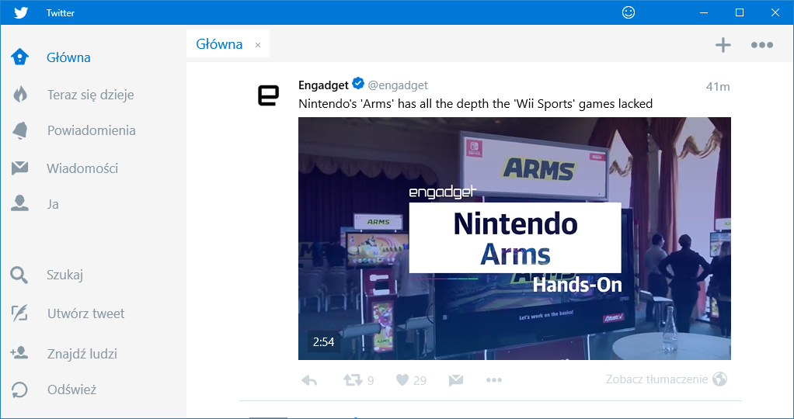
Cross-Platform testing - Desktop
Navigation bar
Tweets
stream

Slide 36
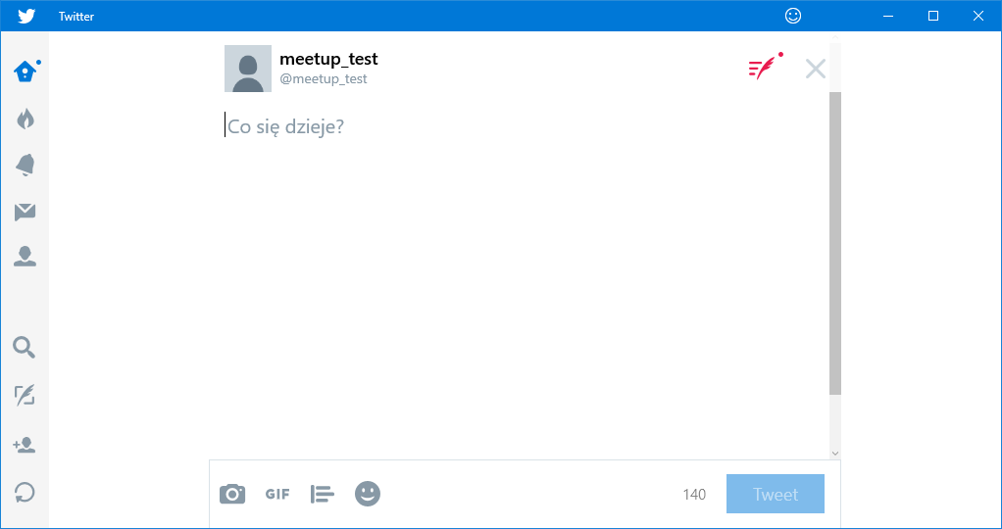
Cross-Platform testing - Desktop
Navigation bar
Publish Tweet

Slide 37
Cross-Platform testing - Page Object Pattern
Publish Tweet Test
TweetLessThan140Signs_Published()
TweetMoreThan140Signs_CannotPublish()
Web
Desktop
Navigation bar
GoToNewTweet()
GoToMessages()
Create Tweet
PutMessage()
Publish()
Tweet stream
GetLastTweet()
ReplayTweet()
GoTo…()
AttacheImage()
…
ForwardTweet()
Navigation bar
GoToNewTweet()
GoToMessages()
Create Tweet
PutMessage()
Publish()
Tweet stream
GetLastTweet()
ReplayTweet()
GoTo…()
AttacheImage()
…
ForwardTweet()
Notes:
- Let´s assume that we built Twitter website and we want to implement automated tests for it.
- As most important thing on twitter is publishing tweets we will try to test this functionallity. When we are looking at homepage we can see that to publish tweet we need to click input field put

Slide 38
Demo 3
https://github.com/achrapowicki/cross-platform-testing

Slide 39
Page Object Pattern - Summary
Makes tests more readable
Reduces the duplication of code
Changes in the UI doesn’t break multiple tests
Allow to separate the tests logic from manipulation with application
Opened for the new platforms
Require some effort at the begining to implement the basic framework and PageObjects
Notes:
That’s all I wanted to share with you today. Any Questions?

Slide 40

Q&A
Notes:
- that’s all what I wanted to show you today. Do you have any questions?

